Slide 1
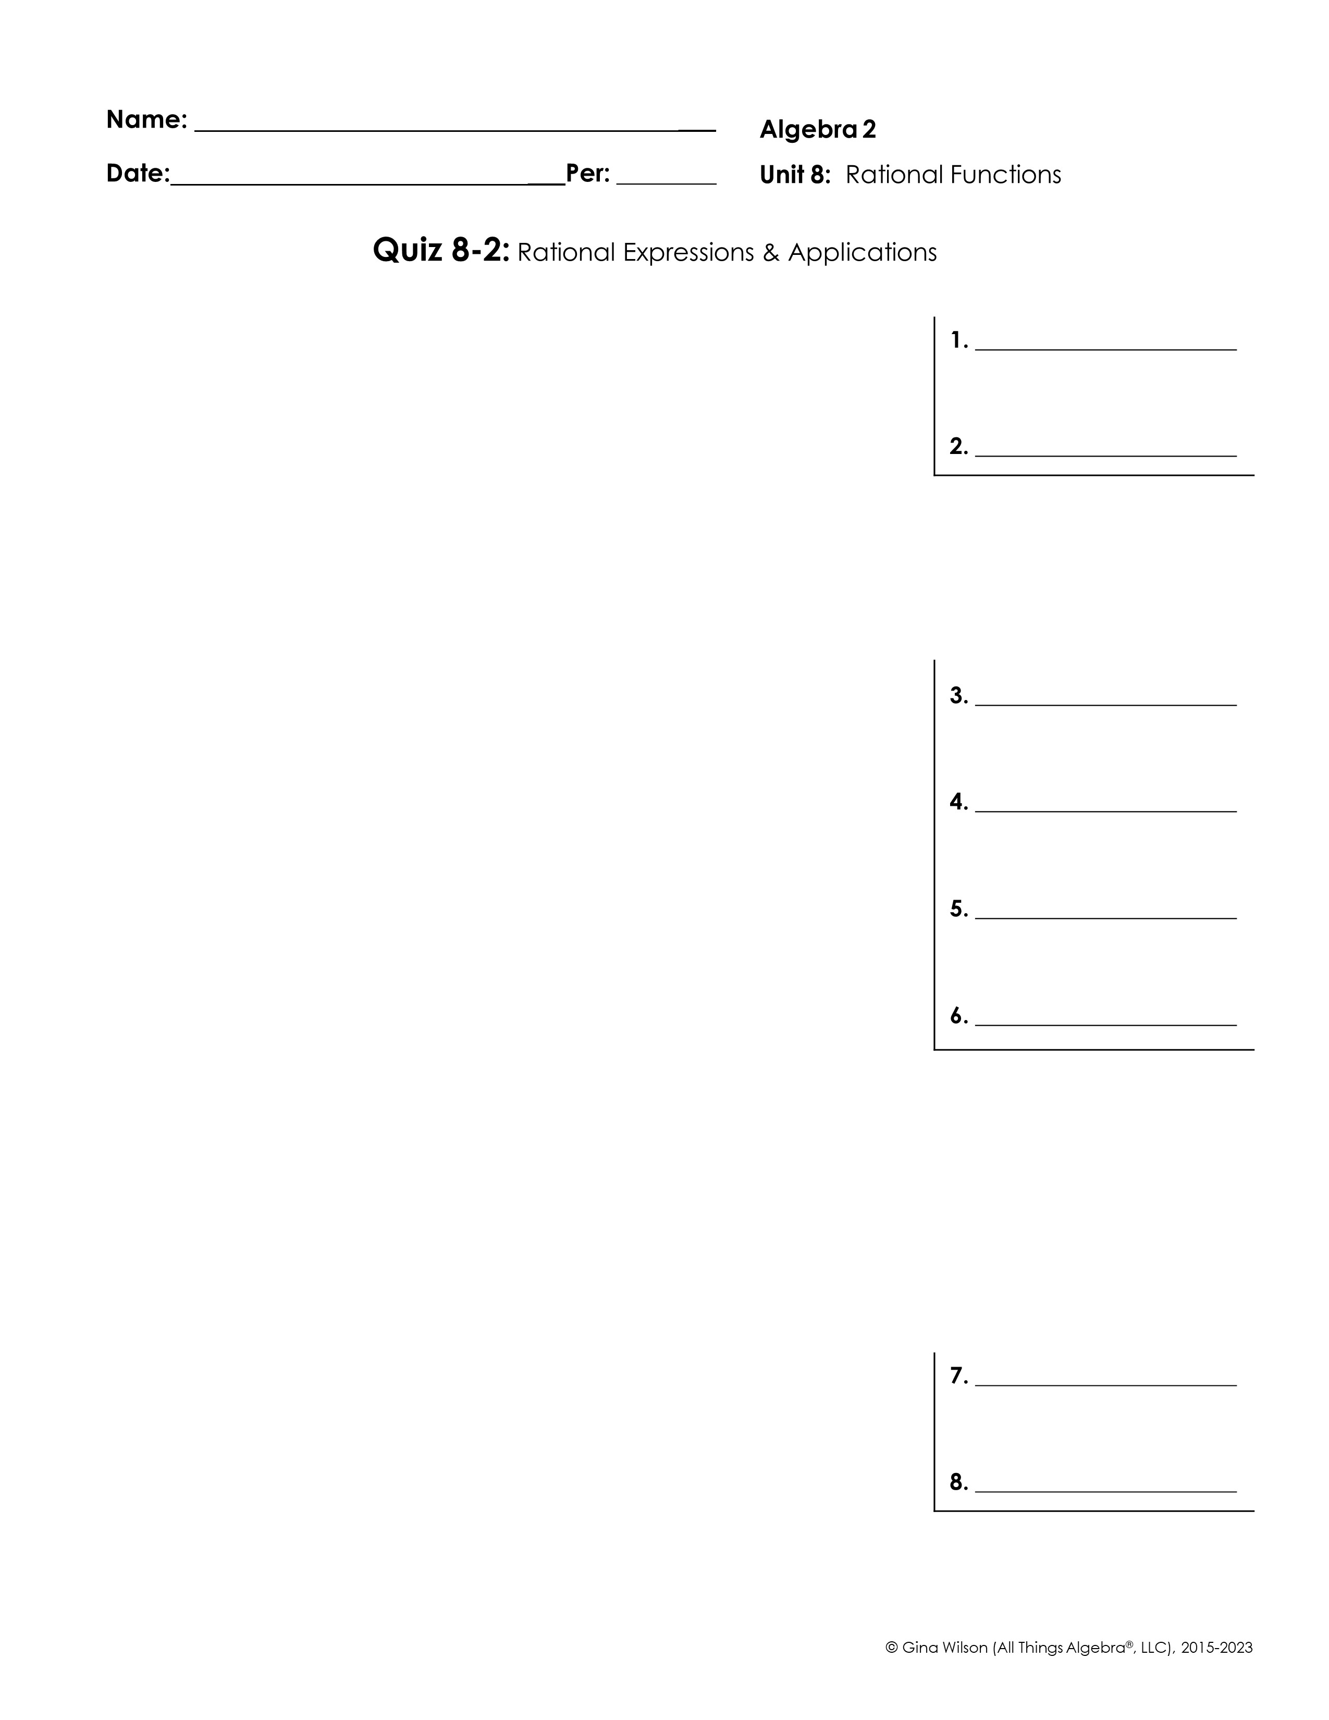
Simplify each expression.
1.
2.
Find each product or quotient.
3.
4.
5.
6.
Find each sum or difference.
7.
8.

Slide 2
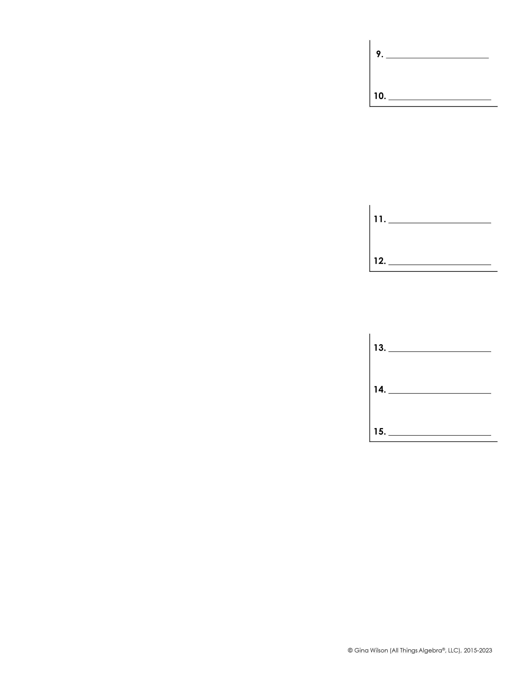
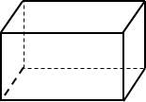
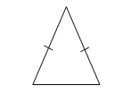
9.
10.
Simplify each complex fraction.
11.
12.
13. Find the area of the rectangle below.
14. If the rectangular prism below has a volume of ,
find its length, l.
15. Find the perimeter of the triangle below.

